Slide 1
Mechanism Descriptions in Detail
Represent the Function, Appearance and Operation of an Object

Slide 2
Model for a Mechanical Description
I. Introduction: General Description
Definition, Function, and Background of the item
Purpose (Audience appropriate, of course)
Overall Description (with general visuals, where applicable)
Principle of Operation (if applicable)
List of Major parts
II. Description & Function of Parts
Part One in Your Descriptive Sequence
Definition
Shape, dimensions, material, surface finish (with visuals, where required)
Sub-parts or sub-assemblies (if applicable)
Function
Relation to adjoining parts
Mode of attachment (if applicable)
Part Two in Your Descriptive Sequence (and so on)

Slide 3
Model for a Mechanical Description
III. Summary & Operation Description
Summary (used only in a long complex description)
Interrelation of parts
Description of one complete Operating Cycle (if with visuals, if applicable)

Slide 4
Definition
A mechanism description analyzes (that is, subdivides into components for further scrutiny) an object in space.
When you try to organize your major subsections, if no other obvious pattern seems appropriate, you can always fall back on the “more-important-to-less-important strategy” or the “outside-to- inside” strategy, even biggest to smallest part will work in some cases. Use careful judgment about your organizing principle.

Slide 5
Writing the introduction
Your introduction should first state the purpose and scope of your document. If your document is longer than a few paragraphs, the first paragraph should be a stand-alone summary, which briefly defines the object and explains its function, appearance, and operation.

Slide 6
Bad introduction
✖ Wrong!
Throughout the ages, mankind has found many uses for salt. Ancient tribes used it preserve meat; around the world it adds flavor to food; the Bible uses it as a symbol of zest for life. Salt became such an important part of people’s diet that a way was needed to allow early nomads to carry salt with them on their perilous travels; such a device ideally also helped ancient gormandizers to distribute portions of the precious flavor enhancer onto their foods. Thus the salt shaker was born .
You’re not writing a movie trailer. Just provide the necessary information as efficiently as possible.

Slide 7
Good introduction
✔ Right!
This document provides the manufacturing specifications for the entire line of Happy Homemaker “Praying Cow” salt shakers (Divine Bovine Industries model #00045). A hand-painted ceramic collector’s item, the “Praying Cow” salt shaker represents a plump, cartoon-like cow, her head bowed as if in prayer. A blue flower-print skirt is painted onto the body of the animal. The salt is dispensed through the cow’s matching bonnet, via a circular array of six small holes. The bonnet twists off to allow the consumer to fill the dispenser cavity.
Note: this writer begins by introducing the reader to the document. We can assume that the rest of the document provides the measurements and other technical details, as promised by the opening sentence. The summary paragraph assumes that the reader already knows the definition and function of a salt shaker; this is permissible because it is an everyday object. This would not be the cause for a object that is not in common use.

Slide 8
Describe the function of the object
Answer the question, “What does it do?”
Keep this section brief — chance are, if your reader is interested in a full mechanism description, he or she already has some idea what the object is for.
Of course, if the object will be so unfamiliar to your reader that the rest of the document won’t make sense, then provide whatever background information your reader is likely to need. Sometimes the only way to do this is to show a prototype of your mechanism description to a test user. (See the “Usability Testing” handout.)
If the object participates in a process, then you may need to write a brief process description as well.

Slide 9
Object Description
The original starship Enterprise (featured on Star Trek 1966-69), TV’s most famous fictional spacecraft, has a saucer shaped primary hull, a cigar-shaped secondary hull, and two cylindrical propulsion units. A horizontal strut suspends the secondary hull behind and below the saucer. At the flat, front of the suspended section is the deflector dish, and at the tapered back are clamshell doors that open to reveal a shuttle bay. Each of the two cylindrical power units is supported by a long pylon connected near the rear of the secondary hull. The pylons raise the propulsion units above the plane of the horizontal dish, and extend them outwards roughly to the same width of the saucer. The units themselves have red hemispheres on the front and cylindrical fixtures that taper from front to rear.
Note: this writer begins by introducing the reader to the document. We can assume that the rest of the document provides the measurements and other technical details, as promised by the opening sentence. The summary paragraph assumes that the reader already knows the definition and function of a salt shaker; this is permissible because it is an everyday object. This would not be the cause for a object that is not in common use.

Slide 10
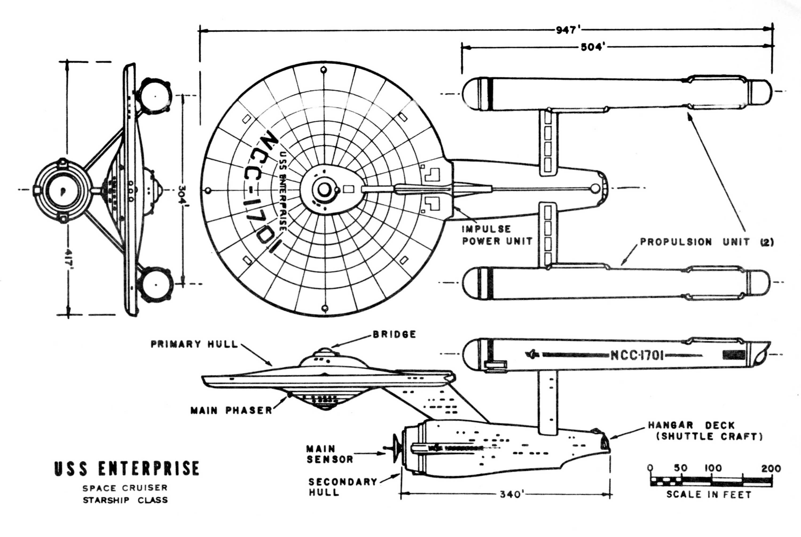
Don’t forget to include images

Slide 11

Going into More detail…
The content of the previous section is good, but it’s a little hard to read. If the writer were to go in to any more detail, it would be necessary to break description up into smaller paragraphs.
If you start to break your object up into multiple nested layers of components, you should consider a bulleted list, formatted so that your reader can more easily identify the level of detail you are describing in any given section.

Slide 12
Bulleted Outline
OVERVIEW
The original starship Enterprise, TV’s most famous fictional starship, is composed of
a saucer shaped primary hull,
a cigar-shaped secondary hull, and
two cylindrical warp engines.
1) The SAUCER-SHAPED PRIMARY HULL contains the following visible features:
The bridge (a circular, domed structure at the center of the upper surface of the saucer).
Several porthole windows.
Vessel identification (black painted capital letters on the upper and lower surfaces of the saucer, reading “U.S.S. Enterprise” and “NCC-1701”)
Phaser and photon torpedo banks (usually depicted as emanating from a spot near the center of the underside of the saucer)
2) The CIGAR-SHAPED SECONDARY HULL contains the following visible features:
(Etc.)

Slide 13
Remember!
When creating a bulleted outline of the objects description, it is still necessary to write a detailed description of each part.
Your mechanical description should have a definition, detailed physical description and function description for each part and/or sub-assembly.
The Bulleted Outline is only used as an information organizer.
N.B. For you mechanism description assignment, DO NOT use a bulleted list.

Slide 14
Describe the operation
Answer the question, “How does it work?”
You could also productively think of this section as the conclusion to your paper. Rarely will you gain anything by writing a cookie-cutter, boring conclusion like,
“Therefore, this paper has shown that the PickMaster 2000 Electric Toothpick Dispenser can be an exciting part of the environment around the cash register in any restaurant.”
Even if an object does not have an exciting or visible method of operating (such as a simple brick), the conclusion should still explain how its design helps it to fulfill its function.

Slide 15

Don’t sell the object
A technical writer is not required to persuade the reader that the object is wonderful, or valuable, or scary. But do mention the details. While you shouldn’t say an object is “adorably cute,” you could mention that it “resembles a cartoon cow wearing a pink ruffled skirt,” and let your readers make the value judgment for themselves.

Slide 16

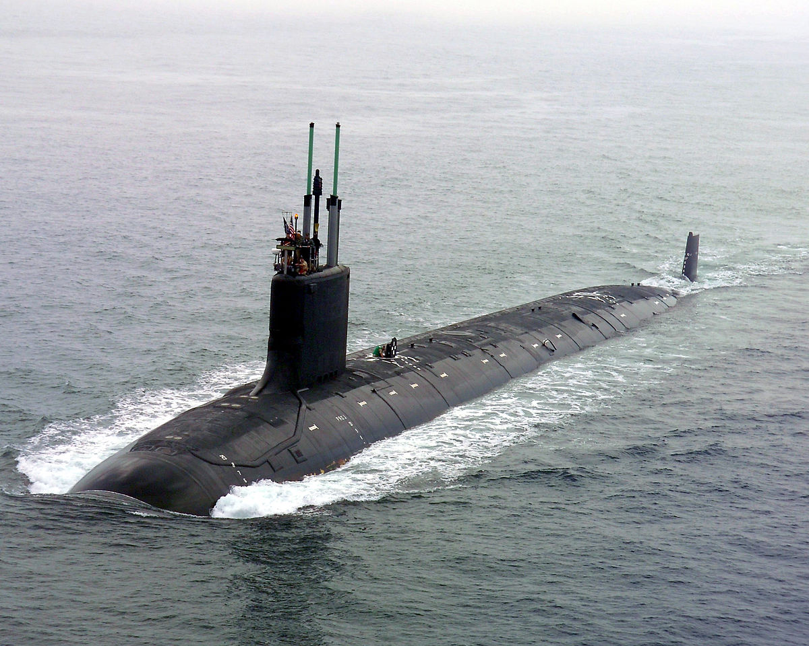
Just describe it
Provide whatever level of detail your reader requires. Know your audience. A child safety organization may require an extremely detailed description of a simple toy (along with a separate process description for the manufacture of each component), while a military recruitment office might require only a few paragraphs about a complex nuclear submarine.

